Slide 1
KNOWLEDGE INSTITUTE OF TECHNOLOGY
Mr. S.SASI KUMAR
AP/PHYSICS
DEPARTMENT OF CIVIL ENGINEERING
SEMESTER-I
SUBJECT:PH8151-ENGINEERING PHYSICS
UNIT: II
TOPIC: LASER

Slide 2
Light Amplification by Stimulated Emission of Radiation

Slide 3
Objectives…
Introduction and understand the principle of LASER
Light Amplification by Stimulated Emission of
Radiation
Absorption
Spontaneous Emission
Stimulated Emission
Population Inversion
Optical Pumping

Slide 4
Objectives…
Characteristics or Properties of Laser Light
Coherence
High Intensity
High directionality
High monochromaticity
Laser light is highly powerful and it is capable of propagating over long distances and it is not easily absorbed by water.

Slide 5
Light having following Properties
  Wavelength
  Frequency
  Amplitude
  Phase
  Coherence/Incoherence
  Velocity
  Direction

Slide 6
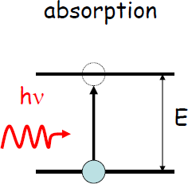
Stimulated Absorption
E₁ = Ground state
E₂ = Excited State
E = hν (Photon Energy)

Slide 7
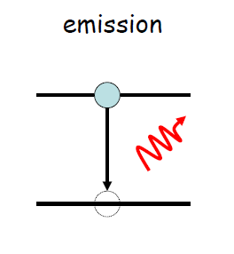
Spontaneous Emission
E₁ = GroundState
E₂ = Excited State
E = E₂ – E₁
= ΔE
= hν

Slide 8
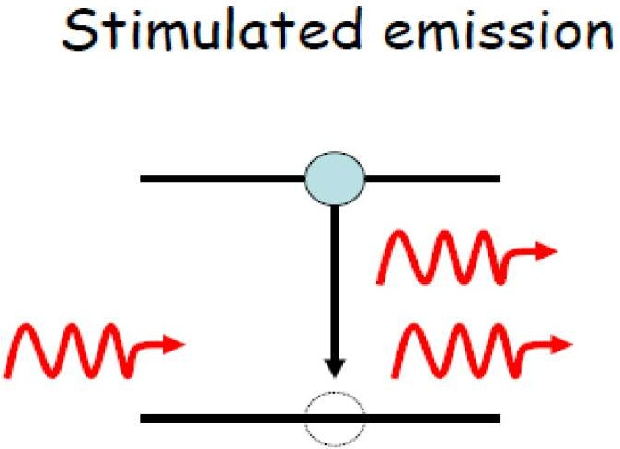
Stimulated Emission

Slide 9
Population Inversion
It is the process of increasing exited electrons in higher energy levels.
Due to this process the production of laser is possible.
The energy level between the ground state E₁ (1st level) and exited state E₃ (3rd level) is known as metastable state E₂ (2nd level).

Slide 10
The electrons remain only for 10⁻⁸ sec in exited state E₃, so most of them jumps back to the ground state E₁ by emitting photons. But some of them jumps to the metastable state E₂.
They (electron) stay in metastable state for more then 10⁻³ sec.
So electron density increases in metastable state.
Thus the transitions are possible it takes more no. of electrons together and ν ^{– (knew)} ₁₂ photon beam is produced which constitute laser beam.

Slide 11
Optical Pumping
There are no of techniques for pumping a collection of atoms to an inverted state.
Optical pumping
Electrical discharge
Direct conversion
When photon of blue green light incident on Ruby crystal, electrons from ground state absorbs and exited and jumps on higher energy state levels and comes back to metastable state. They increase population of electrons in metastable state.
This process is called optical pumping which is done by flash tube.

Slide 12
Types of LASER
There are three types of lasers
  Solid Laser (Ruby Laser)
  Gas Laser
  Semiconductor Laser

Slide 13
Semiconductor Laser (Diode Laser)
A semiconductor laser is a laser in which a semiconductor serves as a photon source.
The most common semiconductor material that has been used in lasers is gallium arsenide.
Einstein’s Photoelectric theory states that light should be understood as discrete lumps of energy (photons) and it takes only a single photon with high enough energy to knock an electron loose from the atom it's bound to.
Stimulated, organized photon emission occurs when two electrons with the same energy and phase meet. The two photons leave with the same frequency and direction.

Slide 14
P type Semiconductors
In the compound GaAs, each Ga atom has three electrons in its outermost shell of electrons and each As atom has five.
When a trace of an impurity element with two outer electrons, such as Zn (zinc), is added to the crystal.
The result is the shortage of one electron from one of the pairs, causing an imbalance in which there is a “hole” for an electron but there is no electron available.
This forms a p-type semiconductor.

Slide 15
N type Semiconductors
  When a trace of an impurity element with six outer electrons, such as Se (selenium), is added to a crystal of GaAs, it provides on additional electron which is not needed for the bonding.
  This electron can be free to move through the crystal.
  Thus, it provides a mechanism for electrical conductivity.
  This type is called an n-type semiconductor.

Slide 16
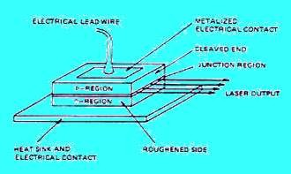
Under forward bias (the p-type side is made positive) the majority carriers, electrons in the n- side, holes in the p-side, are injected across the depletion region in both directions to create a population inversion in a narrow active region. The light produced by radioactive recombination across the band gap is confined in this active region.

Slide 17
Application of Lasers…
Laser beam is used to measure distances of sun, moon, stars and satellites very accurately.
It can be used for measuring velocity of light, to study spectrum of matters, to study Raman effect.
It can be is used for increasing efficiency of computer.
It is used for welding.
It is used in biomedical science.
It is used in 3D photography.

Slide 18
Application of Lasers…
It is used for communication, T. V. transmission, to search the objects under sea.
It can be used to predict earthquake.
Laser tools are used in surgery.
It is used for detection and treatment of cancer.
It is used to aline straight line for construction of dam, tunnels etc.
It is used in holography.
It is used in fiber optic communication.
It is also used in military, like LIDAR.
It is used to accelerate some chemical reactions.

